Slide 1
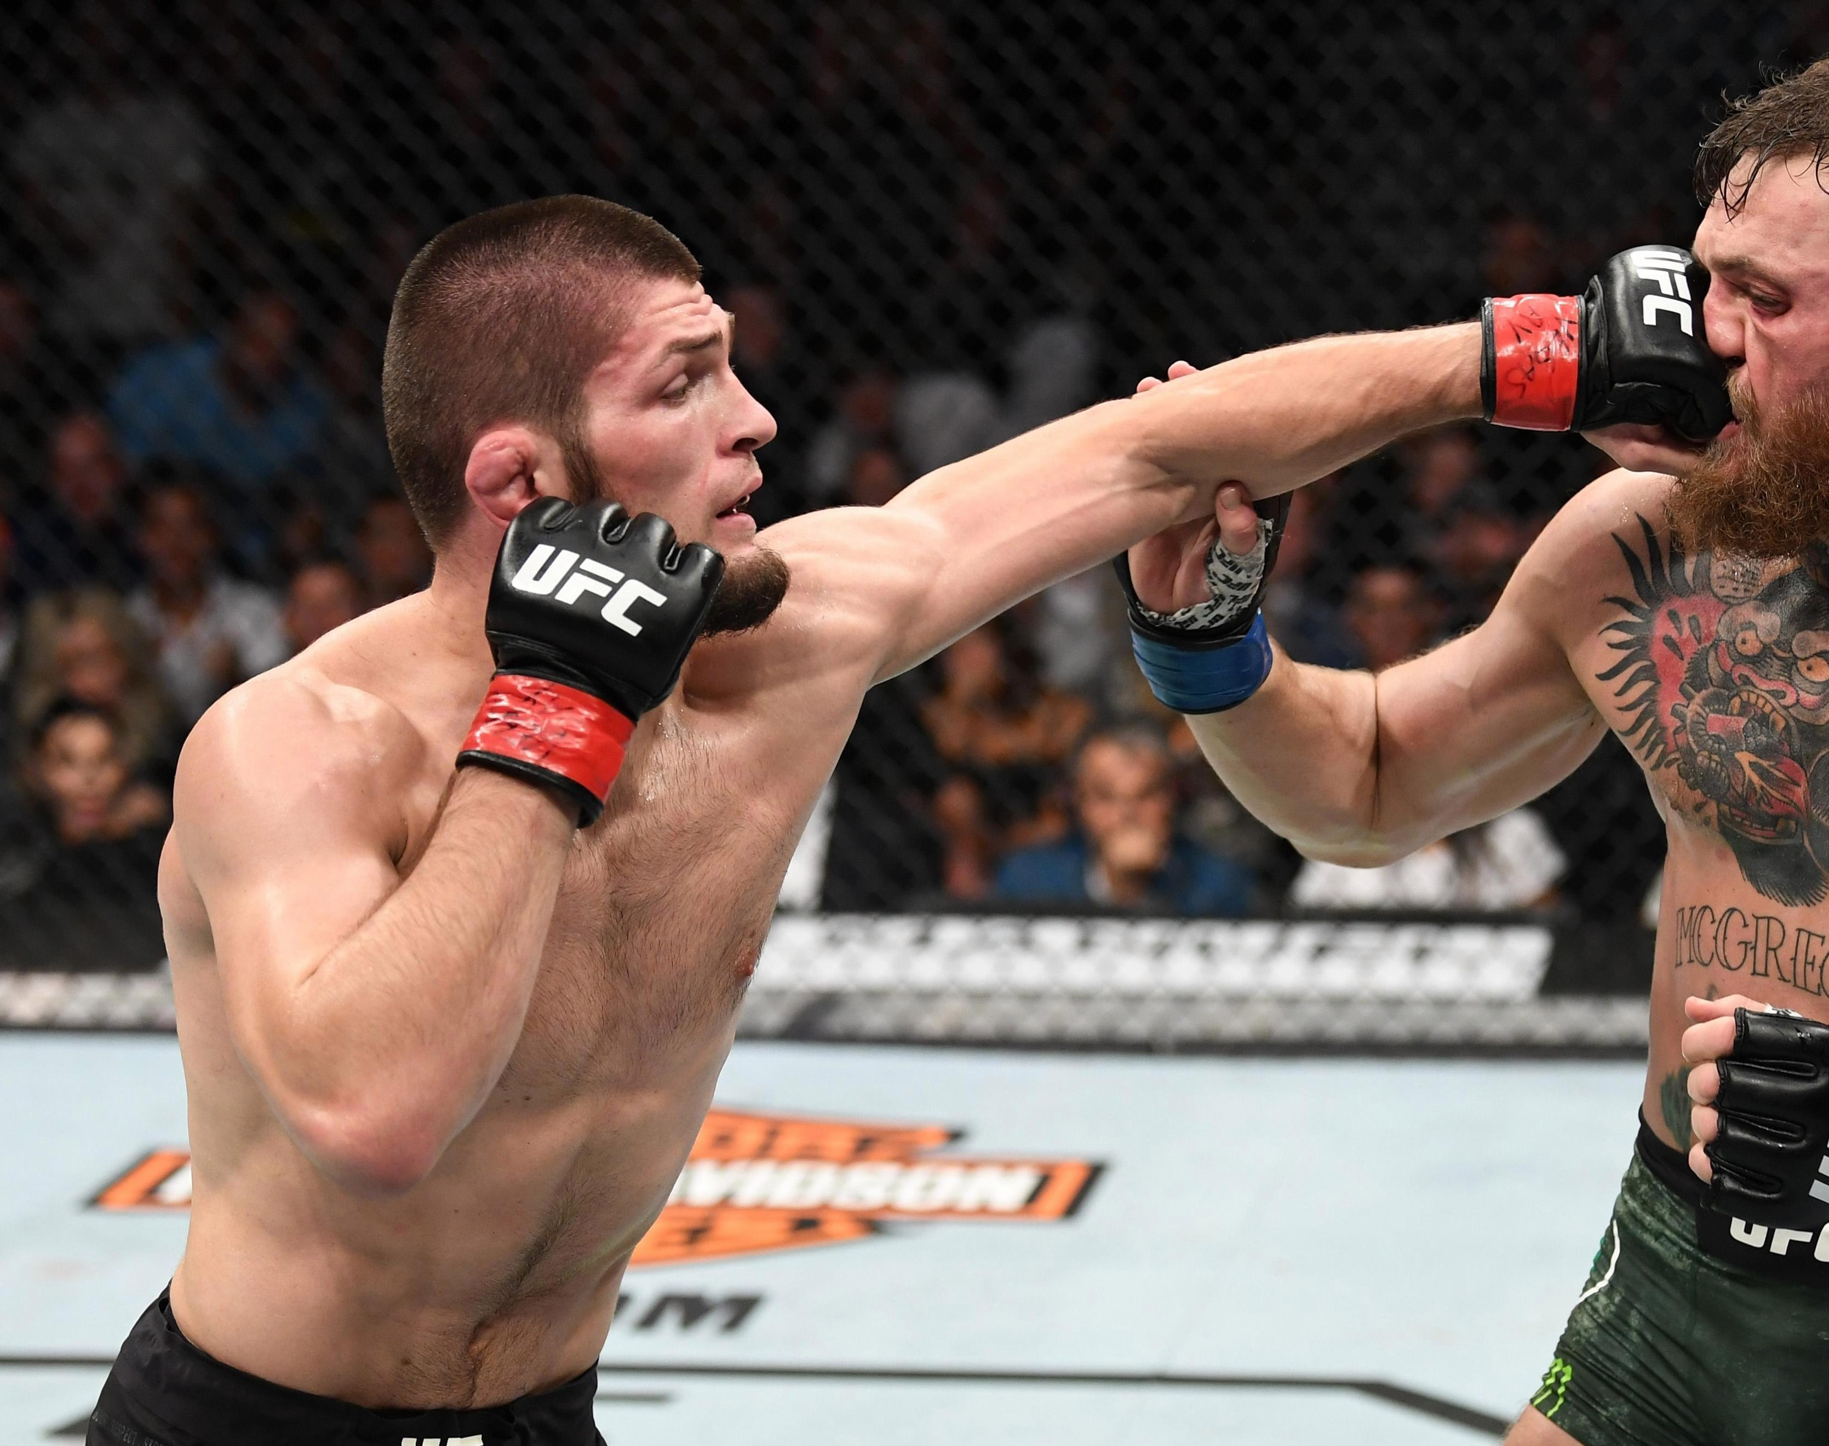
Optimizing sportsbook betting odds for UFC fights
Kester Chia

Slide 2
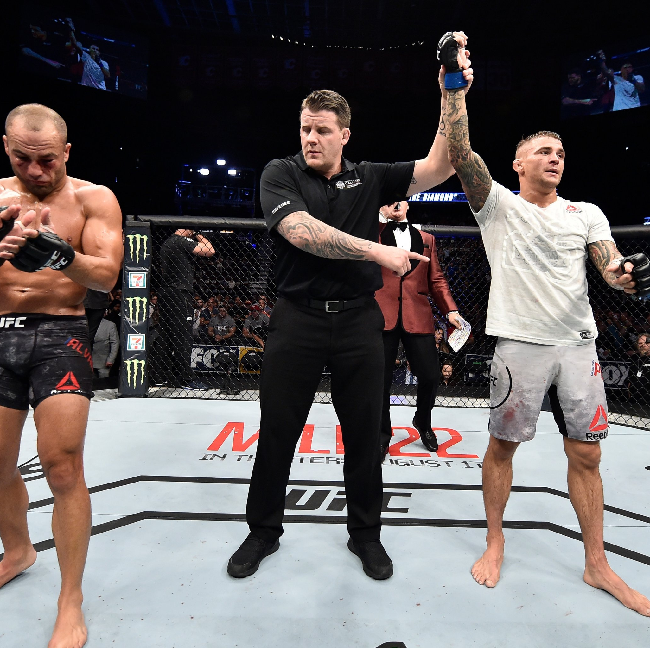
What is UFC?
The Ultimate Fighting Championship is a mixed martial arts (MMA) company which hosts fights
Fights are always between two fighters in a cage
Fights continue until a knockout (KO) is achieved or the last round is over.
Draws almost never happen in UFC fights

Slide 3
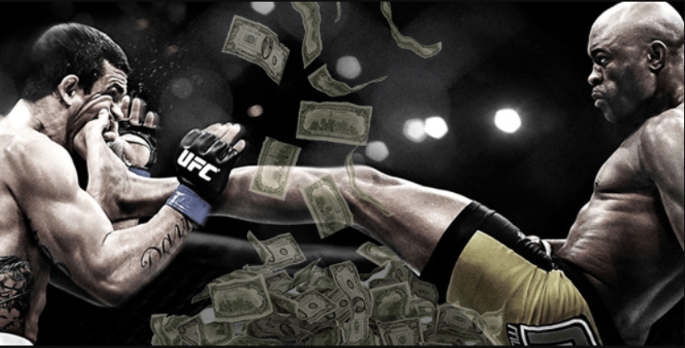
Gambling in UFC Fights
Fight betting is a huge industry, with a variety of betting companies offering competitive rates
Involves huge amounts of money: online betting market is worth 58.9bn USD

Slide 4
Gambling in UFC Fights
Betting sites entice bettors with competitive odds:
Example odds:
(-300) means that you would have to bet $300 for a $100 return
(+250) means that you would only need a $100 bet for a $250 return

Slide 5
More on Gambling Odds
For every betting site, the fight odds are based on predictions on who the winner will be
The more likely a fighter is predicted to win, the lower his odds will be placed to discourage people from betting on him and vice versa.
An example for illustration:

Slide 6
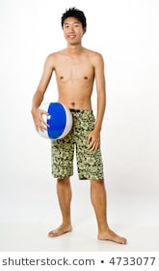
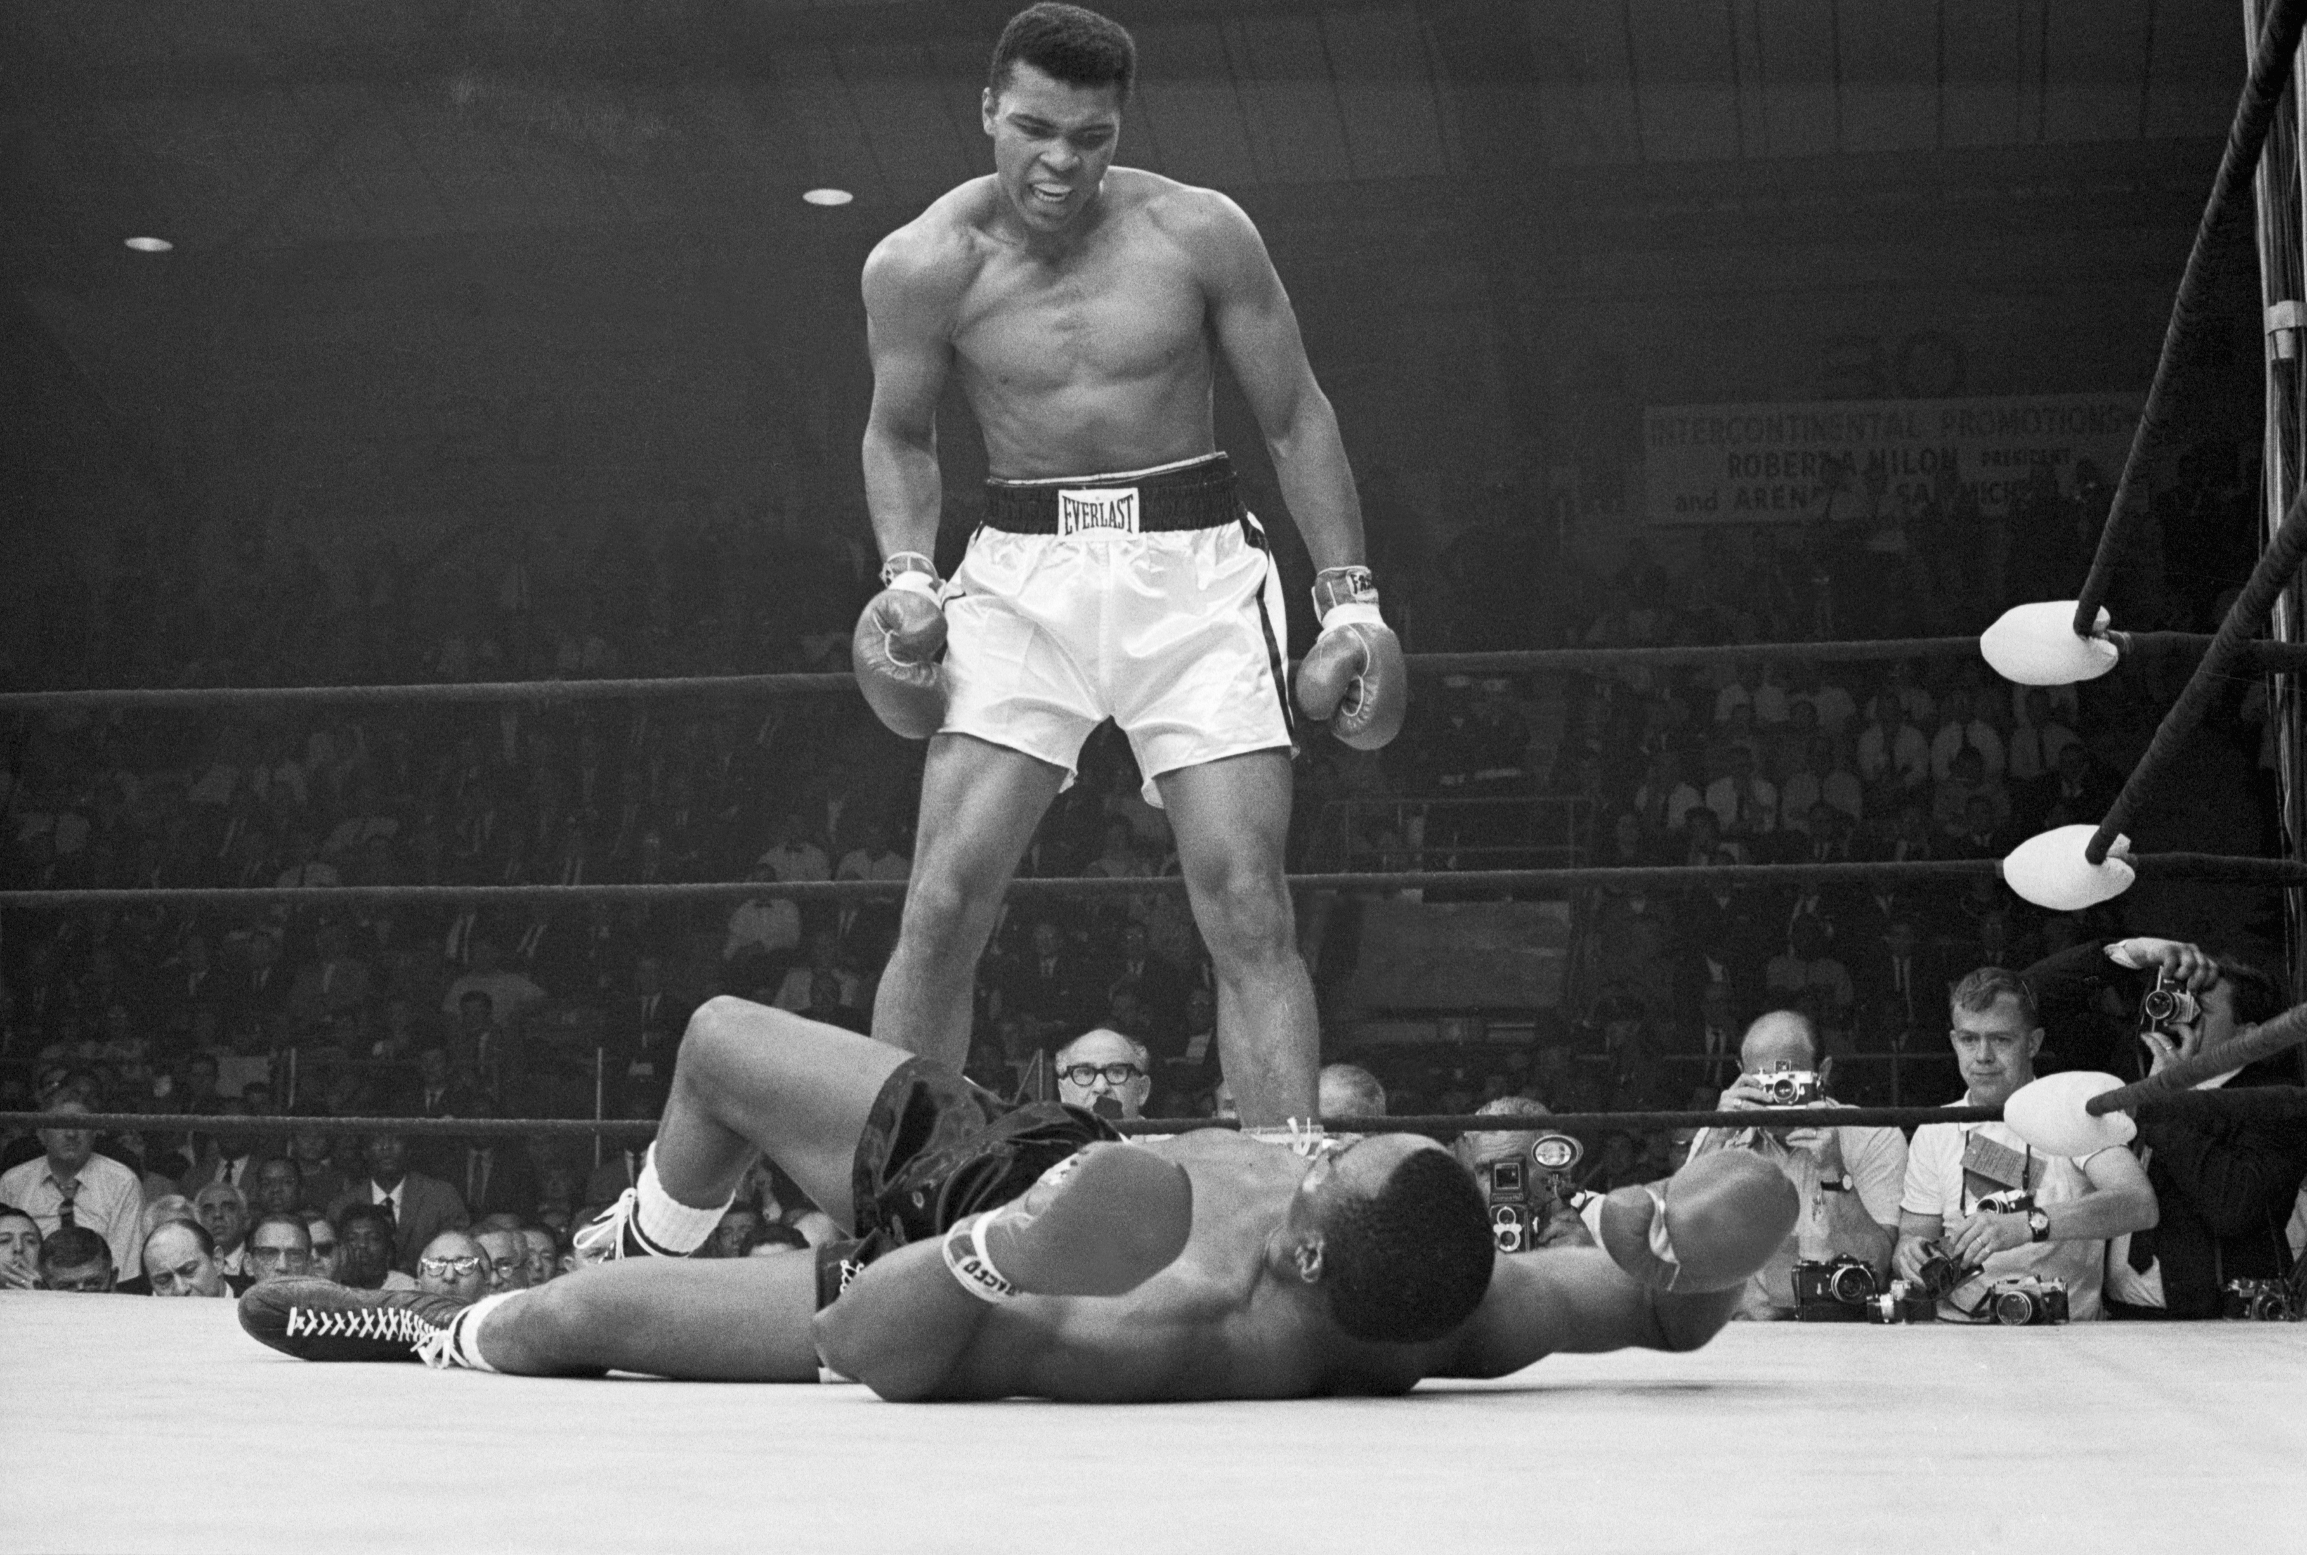
More on Gambling Odds
For every betting site, the fight odds are based on predictions on who the winner will be
The more likely a fighter is predicted to win, the lower his odds will be placed to discourage people from betting on him and vice versa.
An example for illustration:
Muhammad Ali vs. Kester Chia
(-4000)
(+10,000)

Slide 7
More on Gambling Odds
Fight betting organizers must choose their odds wisely so as to not only make profits, but avoid a loss-making fight
Risks organizers face:
Setting odds too low (too conservative):
This results in low consumer demand for bets, as the bets will simply be not worth the risk to bettors.
Setting odds too high (too confident):
This results in potentially significant losses for the organizer as the bettors are winning more than they are losing.
Predicting the wrong winner:
This is the worst possible outcome, and the organizers will make a significant loss
In fact, later analysis will reveal they get the winner wrong ~35% of the time!

Slide 8
More on Gambling Odds
Fights are getting more difficult to predict because of fighters “padding” their win records with easy fights
This means fighters with a 15-0 win record may not be as strong as a 10-5 fighter
There are also many fights for every event, and analyzing each upcoming fight individually takes a significant amount of time
Can we develop a model to optimize betting odds in order to:
More reliably predict the winner,
Quickly determine betting odds, saving resources and time,
Reduce risk to the betting site, and
Maximize profits?

Slide 9
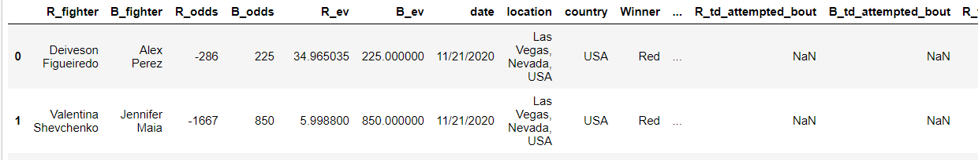
Dataset
Source: https://www.kaggle.com/mdabbert/ultimate-ufc-dataset?select=ufc-master.csv
Dataset consists of information for every UFC fight since 2010
That’s about ~4500 fights with 108 variables, including fighter styles, takedown rates, etc.

Slide 10
1. Basic EDA

Slide 11
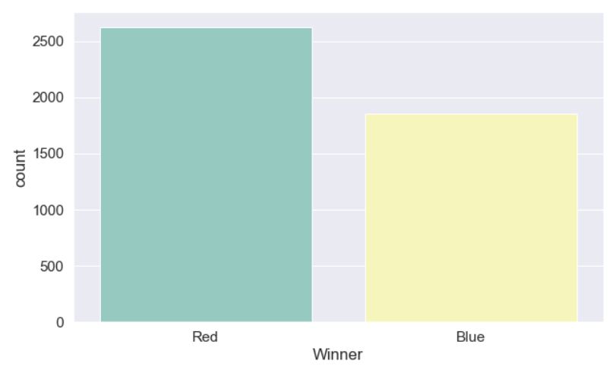
1. Basic EDA
Dataset is well balanced between the Red/Blue corner winning
In general, the red corner tends to be the fight favourite

Slide 12
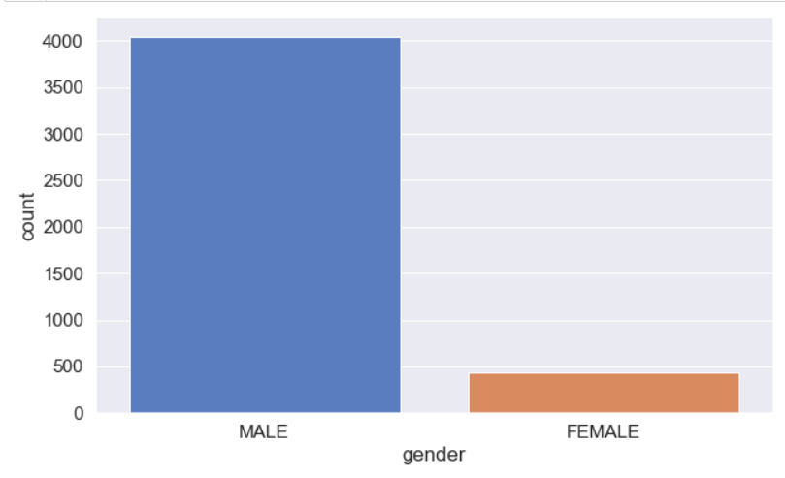
1. Basic EDA
Male fights are a lot more common than female fights, which is expected since MMA is male-dominated
Model must be able to generalize across fights from both genders, especially

Slide 13
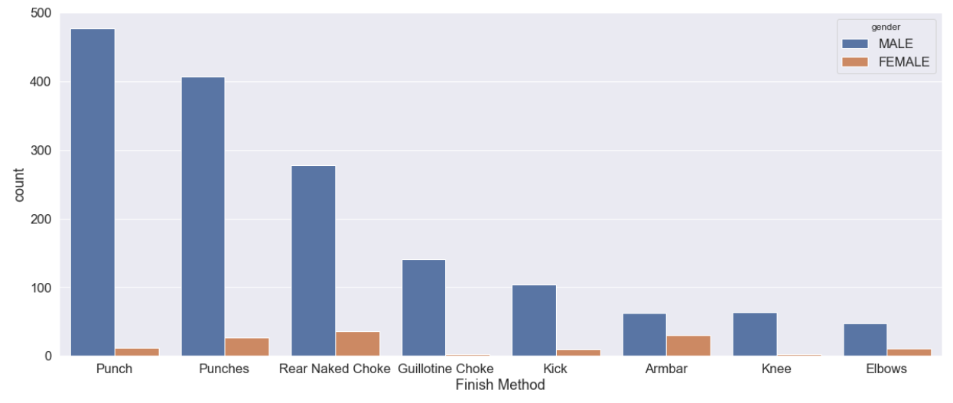
1. Basic EDA
Males tend to have more success with knockout finishes, whereas females have more success with submission finishes

Slide 14
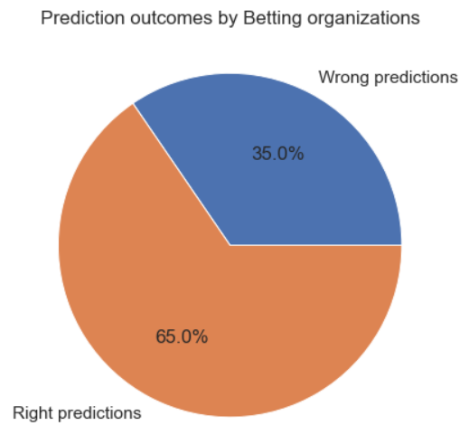
1. Basic EDA
Betting organizations only get fight predictions right 65% of the time!
On the 35% that they get wrong, the gambling odds are many deviations from the optimum, and they suffer significant losses

Slide 15
2. Data Cleaning

Slide 16
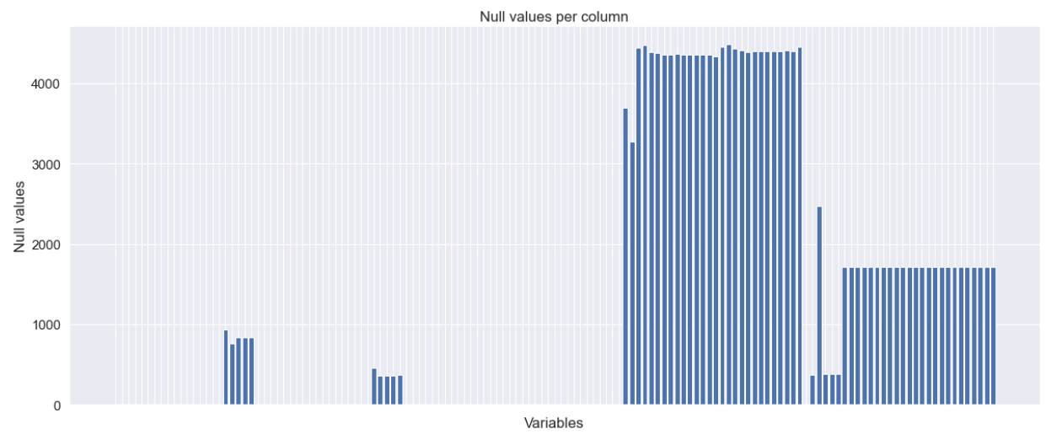
2. Data Cleaning
Significant amount of null values present in the data

Slide 17
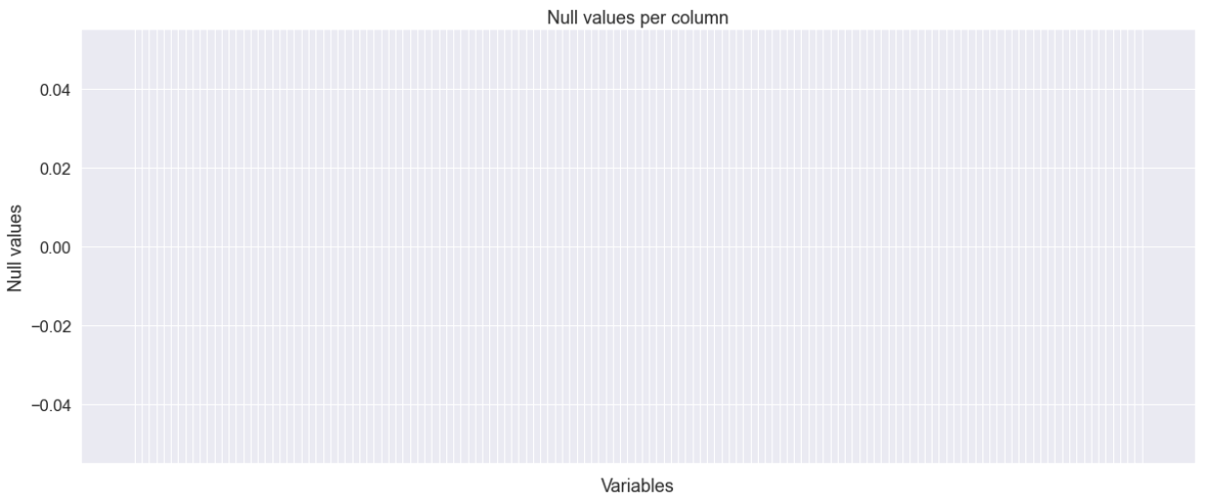
2. Data Cleaning
Imputing categorical variables:
Simple imputer replacing null values with category modes
Imputing numerical variables:
Iterative imputer; uses Bayesian Ridge Regression to impute null values based on other variables.
Iterates over each variable in a round-robin fashion until all columns are imputed
After cleaning:

Slide 18
2.1: Data Preprocessing:
Encoded categorical variables (Binary Encoding instead of Dummy)
Scaled numerical variables (Robust scaler used as some variables exhibit significant skew)
Principle Component Analysis (PCA) decomposition performed
56 out of 140 components kept, explaining 95% of total data variance
Recursive Feature Elimination (RFE) performed
Pruned PCA components from 56 down to 30

Slide 19
3. Model Implementation

Slide 20
3. Model implementation:
Simple Models applied:
Logistic regression
Support vector machines
K-Nearest neighbors
Ensemble Models:
Random Forest
Stacked Classifier (of the four simple models above)
AdaBoost
Neural Networks:
Dense, Fully connected NN

Slide 21
3. Model implementation:
Tuning:
All model hyperparameters were adjusted using sklearn’s GridSearchCV
The neural network was tuned using Keras Tuner, with the HyperBand algorithm
Testing:
All models were tested and tuned using training and validation data
Evaluation metrics are based on unseen test data

Slide 22
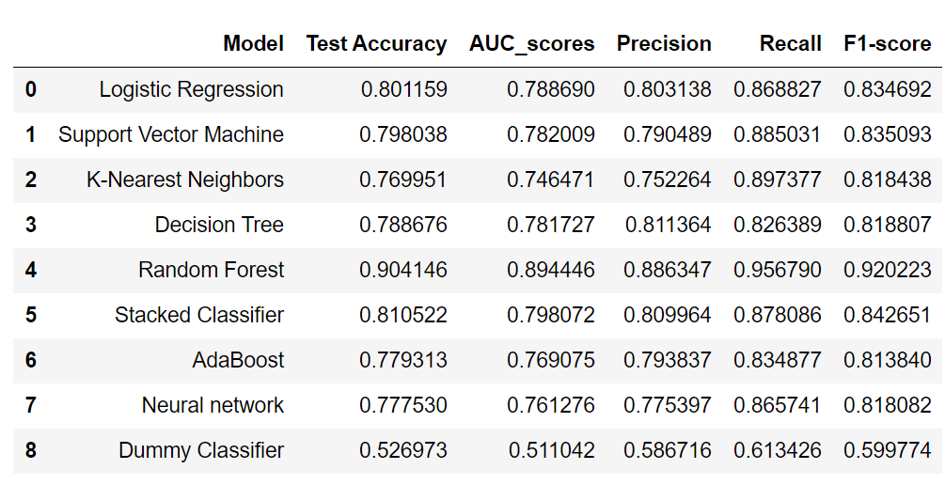
3. Model implementation:
Results:

Slide 23
3. Model implementation:
Random forest parameters:
No. of trees = 400
Unlimited max tree depth
Criterion for splits: Gini impurity
Bootstrap sampling used for each tree
Equal weights given to both classes

Slide 24
4. Model evaluation

Slide 25
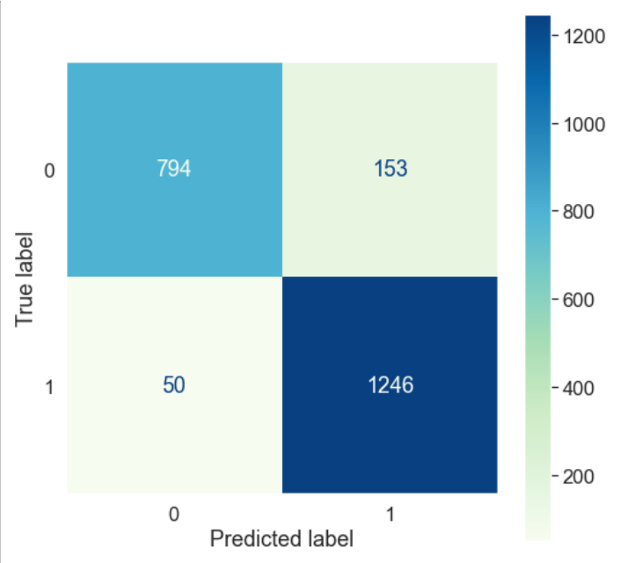
4. Evaluation
Note that the label = 1 refers to the Red corner winning
The model seems to favor the red corner a little more, as it missed only 3% of Red-corner winner, but missed 16% of Blue-corner winners
Confusion matrix:

Slide 26
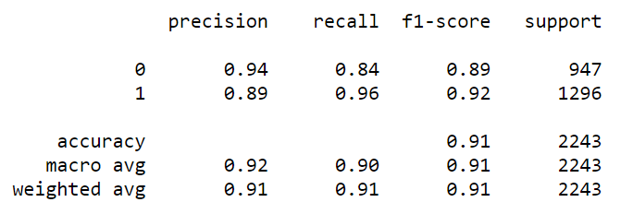
4. Evaluation
Again as we noticed in the confusion matrix, the recall rate for Red-corner winners is much higher (96%) than the Blue-corner winners (84%)
However the accuracy of the model in generally is pretty good at a weighted accuracy of 91%
Classification Report:

Slide 27
5. Creating a tool to optimize betting odds

Slide 28
5. Creating a tool to optimise betting odds
Here we make a tool to optimise the betting odds based on predicted win probability of each fighter
Since a random forest model cannot produce easily interpretable probabilities, we need to calibrate the model
After creating a calibrated model, we need a function to:
Predict the winner, based on the fight history of both fighters
Output optimal betting odds

Slide 29
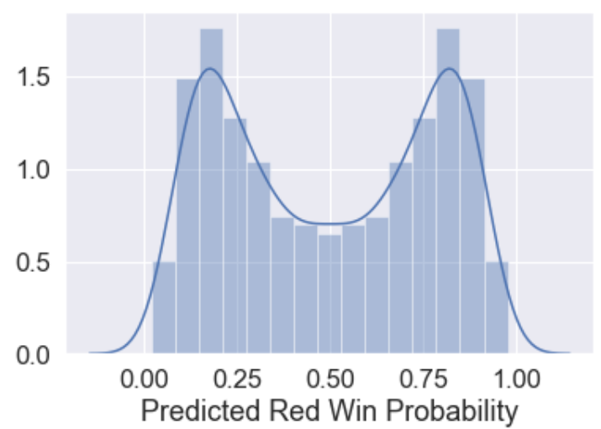
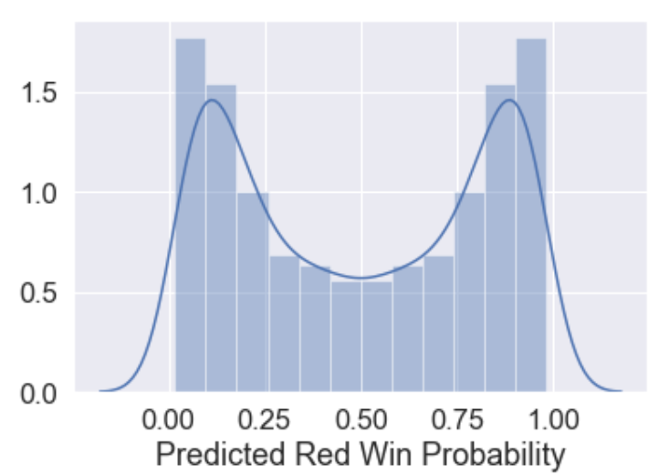
5.1: Calibrating a probability model
The RF model was calibrated using sklearn’s CalibratedClassifierCV, fitting the probability distribution to a sigmoid function
RF Model before calibration
RF Model after calibration

Slide 30

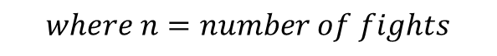
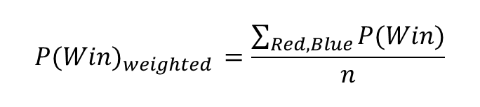
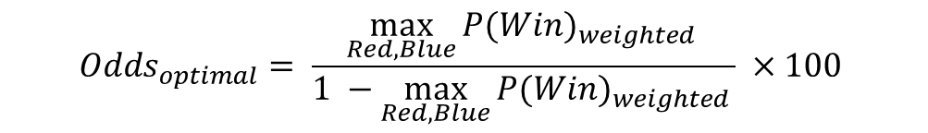

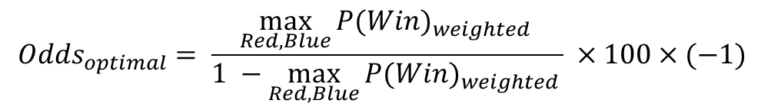
5.2: Creating a function to output optimal odds
$${P(Win)}_{weighted }=\frac{\sum_{Red,Blue}{P(Win)}}{n}$$
$$For {P(Win)}_{weighted }≥0.5:$$
$${Odds}_{optimal}= \frac{\max_{Red,Blue}{{P(Win)}_{weighted }}}{1 −\max_{Red,Blue}{{P(Win)}_{weighted }}} ×100×(−1)$$
$$For {P(Win)}_{weighted }<0.5:$$
$${Odds}_{optimal}= \frac{\max_{Red,Blue}{{P(Win)}_{weighted }}}{1 −\max_{Red,Blue}{{P(Win)}_{weighted }}} ×100$$
$$where n=number of fights$$

Slide 31
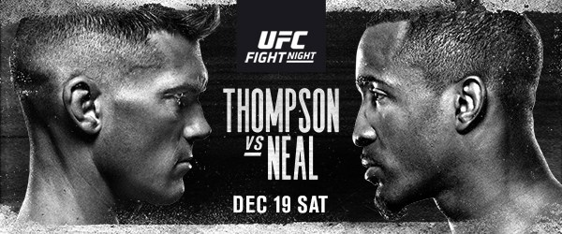
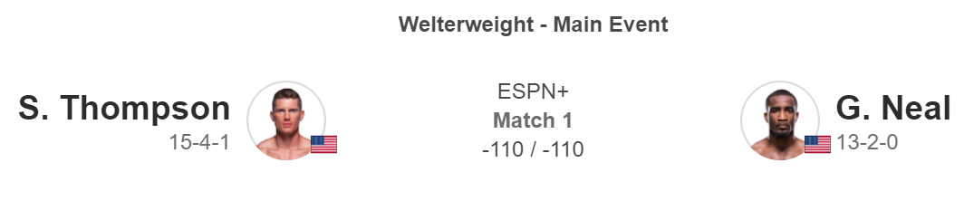
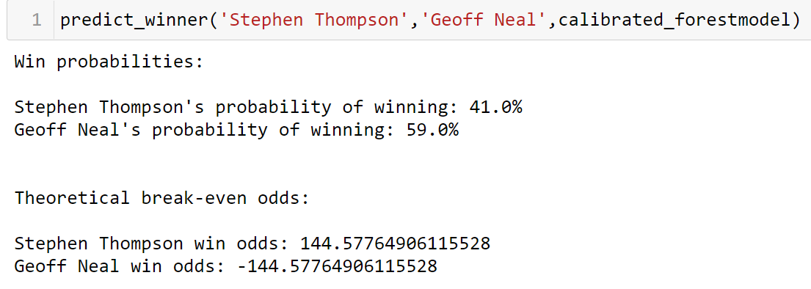
5.3: Finished product in code:

Slide 32
6. Final thoughts

Slide 33
6. Final thoughts:
Advantages
The model returns a much higher accuracy than a baseline dummy classifier
This tool would be useful for betting sites to quickly get the optimal betting odds for upcoming fights
This allows betting sites to save resources and time, as there are too many fights to get domain experts to study each one in detail for every fight
As the base model is a random forest, aside from prediction, users can also easily find which variables contribute the most to winning
Betting sites can then tune the odds up or down depending on their preferences:
High risk or conservative approaches

Slide 34
6. Final thoughts:
Weaknesses
Model assumes equal demand for the underdog and favorite
In reality this is never the case; more competitive odds must typically placed on the underdog to attract demand for bets
Model cannot predict outcomes for new fighters
The function calculates the averages of all previous fights
Without any fight history, the function doesn’t have enough input

Slide 35
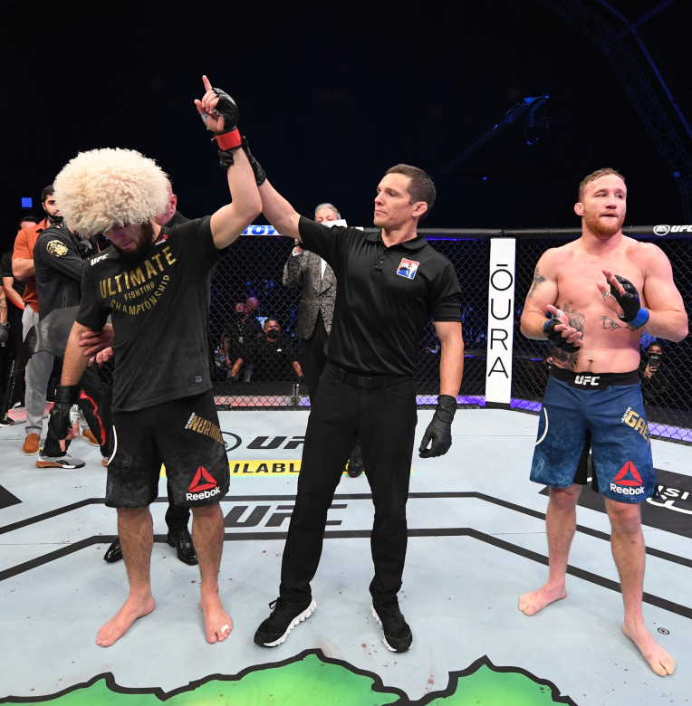
End

